Slide 1
Lecture 10
Topics
  Programmable Logic Devices (PLDs)
    PROMs
    PLAs
    PALs and GALs
  Positive and Mixed Logic

Slide 2
Taxonomies of ICs
Design Methodology
  Standard Components (SSI/MSI/LSI)
    Off-the-shelf Components
    Basic Universal Building Blocks (AND, OR, NAND, NOR…)
  Application-Specific Standard Parts (ASSP)
    Target Specific Application Area, but not Customer
    e.g. Printer Controller, USB Interface IC, HDD I/F
  Application-Specific IC (ASIC)
    Custom Design of IC Targeting Specific Market
    Full-custom, standard cell, gate-arrays
    e.g. ATI 3D Graphics Engine
  Programmable Logic Devices (PLD)
    Can be used to implement wide variety designs
    e.g. FPGA (Field-Programmable Gate Arrays)

Slide 3
PLDs
Programmable Logic Devices (PLDs)
    PROM: Programmable Read Only Memories (1960s)
    PLA: Programmable Logic Arrays [Signetics] (1975)
    PAL™: Programmable Array Logic [MMI] (1976)
    GAL™: Generic Array Logic
    CPLDs (Complex PLDs)
    FPGA: Field Programmable Gate Arrays
PAL™ and GAL™ are registered trademarks of Lattice Logic

Slide 4
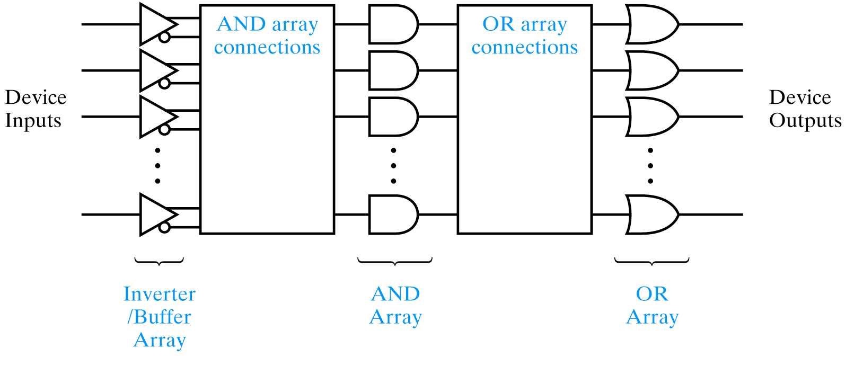
AND/OR Array Architecture
Device type AND array OR array Product term sharing
PROM Fixed at factory Programmable Yes
PLA Programmable Programmable Yes
PAL/GAL Programmable Fixed at factory No

Slide 5
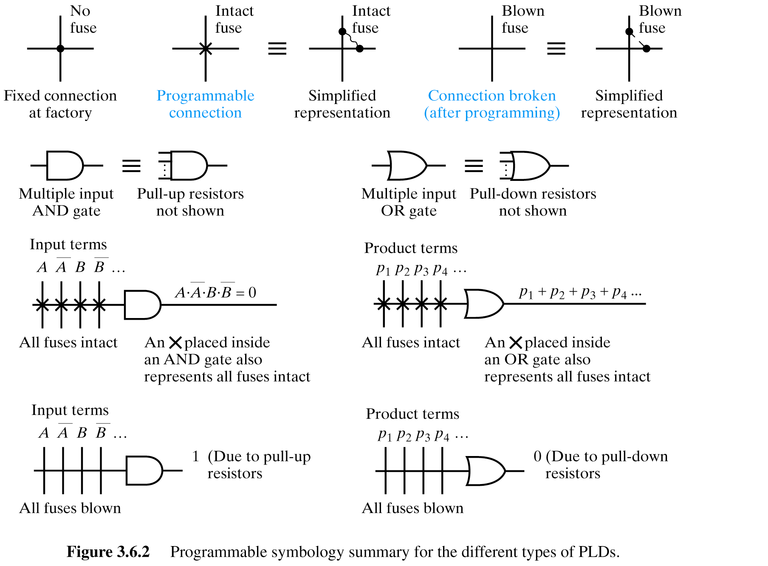
Programmable Symbology

Slide 6
“Fuses”
Actual fuses, transistor circuits, SRAM-based
Volatile and nonvolatile
Nonvolatile
  UV (ultra-violet erasable)
  EE (electrically erasable)
Universal Programming Unit
Fuse map
  JEDEC standard format
  Several programs generate (MACHXL, ABEL, CUPL)

Slide 7
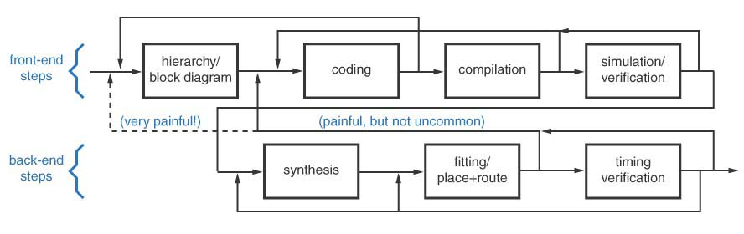
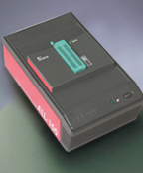
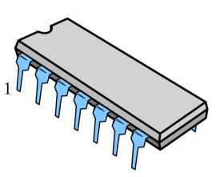
PLD Implementation
PROM
PLA
PAL/GAL
CPLDs
Schematic
Capture
Design
Tools
Fuse
Map
HDL
Universal
Programmer
Tool and PLD vendors: Xilinx, Altera, Lattice

Slide 8
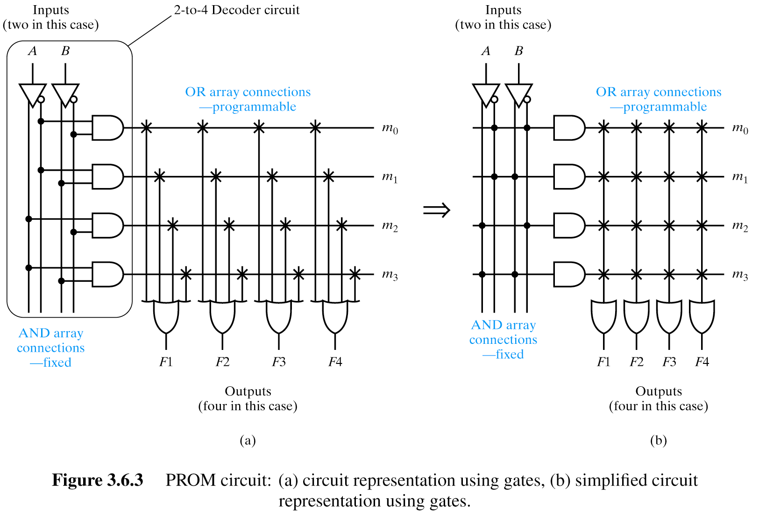
PROMs
Product term sharing

Slide 9
PROMs
How many minterms?
Generating all of them, then select among them,
What’s the impact of adding another input?
Doubling AND array!
MaskROM – fully programmed one time at the factory.
Game cards.

Slide 10
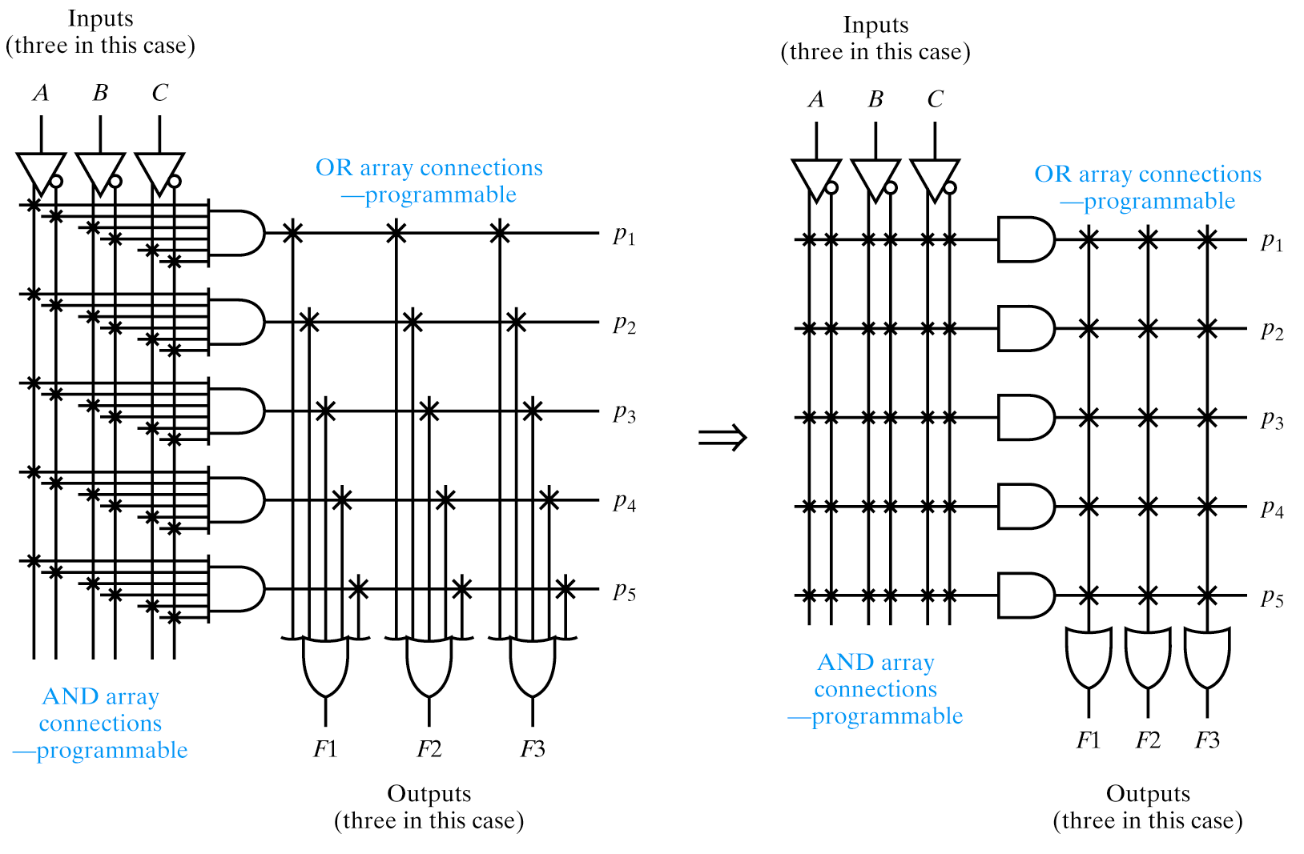
PLAs
Obsolete but show the evolution of PLDs – desire to have programmable AND plane
Product term sharing

Slide 11
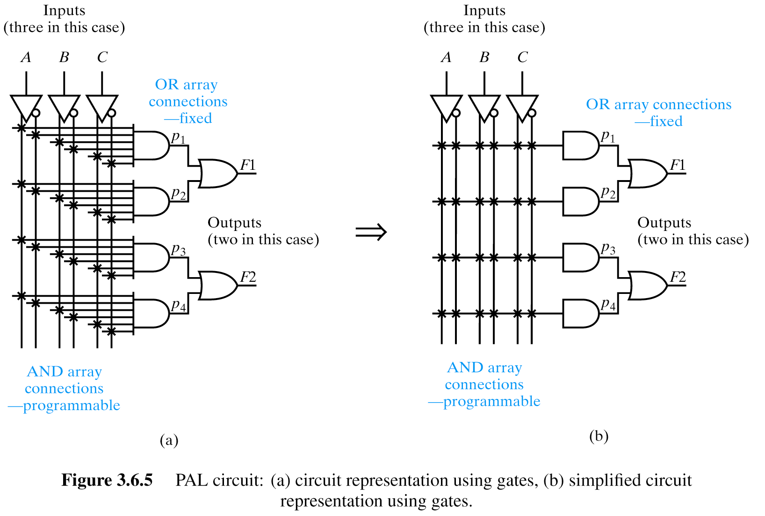
PALs/GALs
No product term sharing
This example shows a PAL that doesn’t permit product term sharing

Slide 12
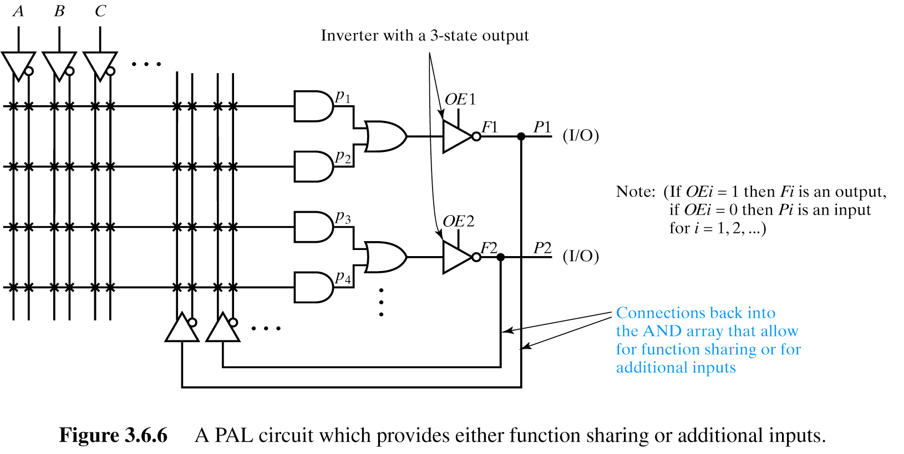
PAL with function sharing or additional inputs

Slide 13
Advantages to PLDs
Shorten design time
  Rapid prototyping!
Rapid design changes
  Reprogrammable
    No masks, jumpers, PCB traces
Decrease PCB “real estate”
  Less space than multiple standard logic packages
Improve reliability
  Fewer packages, fewer external interconnects

Slide 14
PALxxyyzz Nomenclature
xx Maximum number of AND array inputs
zz Maximum number of dedicated outputs
y Type of outputs
Combinational
H active high
L active low
P programmable
C complementary
Registered
R registered
RP registered, with programmable polarity
Versatile
V programmable as combinational or registered

Slide 15
Nomenclature Examples
PAL3H2
3 inputs
2 outputs
Active H outputs
PAL16L8
16 inputs
8 outputs
Active L (0s of function)
PAL22V10
22 inputs
10 outputs
Active L or H (1s or 0s)
Registered if desired

Slide 16
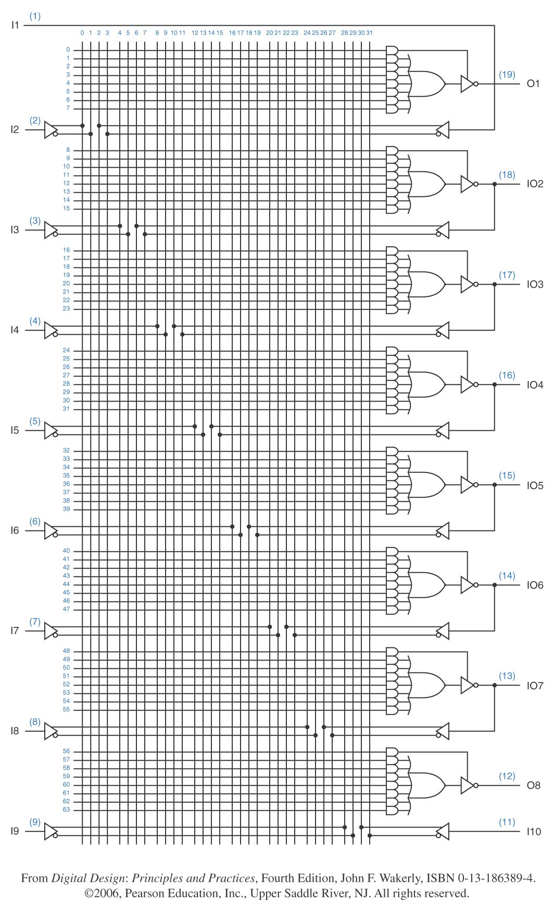
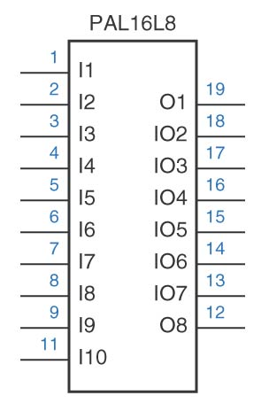
PAL

Slide 17
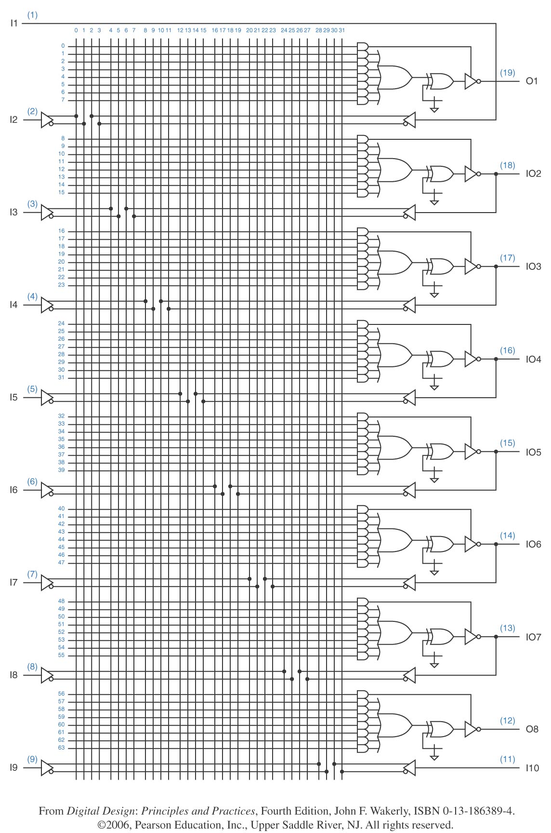
GAL
Emulate any PAL
Reprogrammable
Fuses are non-volatile memory cells

Slide 18
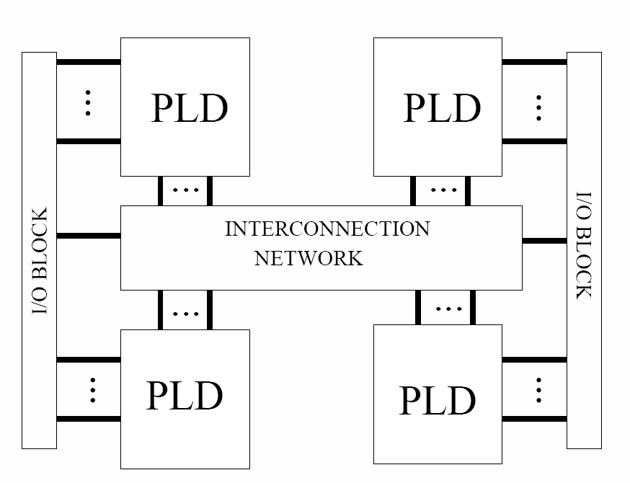
CPLDs – Complex PLDs

Slide 19
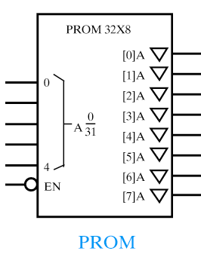
Designing with PROMs
Additional functions/outputs – wider bit word
A B C F
0 0 0 0
0 0 1 0
0 1 0 1
0 1 1 0
1 0 0 0
1 0 1 0
1 1 0 1
1 1 1 1
Address Data
00000 0XXXXXXX
00001 0XXXXXXX
00010 1XXXXXXX
00011 0XXXXXXX
00100 0XXXXXXX
00101 0XXXXXXX
00110 1XXXXXXX
00111 1XXXXXXX
F
C
B
A

Slide 20
Example of implementing the same function with PROM, PLA and PAL

Slide 21
Example
Implement:
an inverter (NOT)
an OR gate
a NAND gate
an XOR gate
With:
a PROM
a PLA
a PAL
A B F1 F2 F3 F4
0 0 1 0 1 0
0 1 1 1 1 1
1 0 0 1 1 1
1 1 0 1 0 0

Slide 22
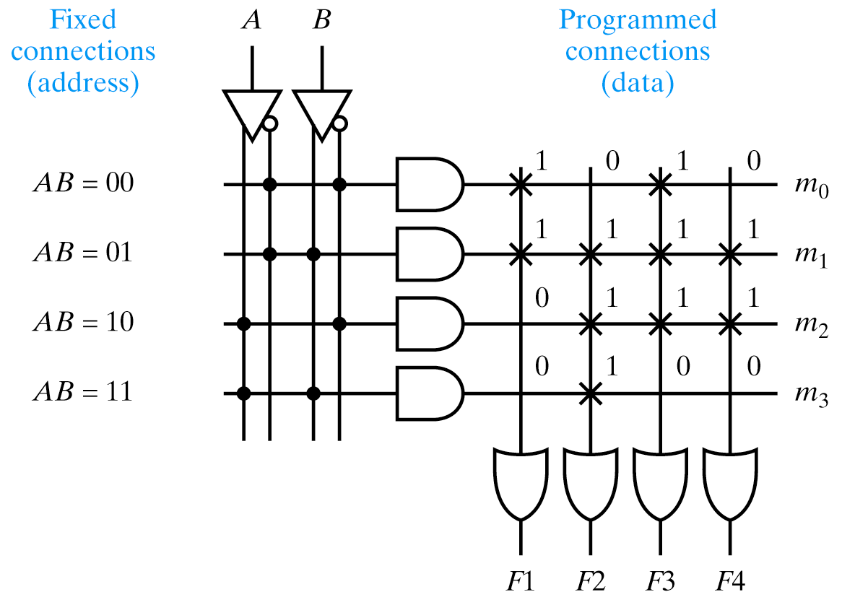
PROM Implementation
NOT, OR, NAND, XOR
A B F1 F2 F3 F4
0 0 1 0 1 0
0 1 1 1 1 1
1 0 0 1 1 1
1 1 0 1 0 0
Fuse map
Address Data
0 A
1 F
2 7
3 4

Slide 23
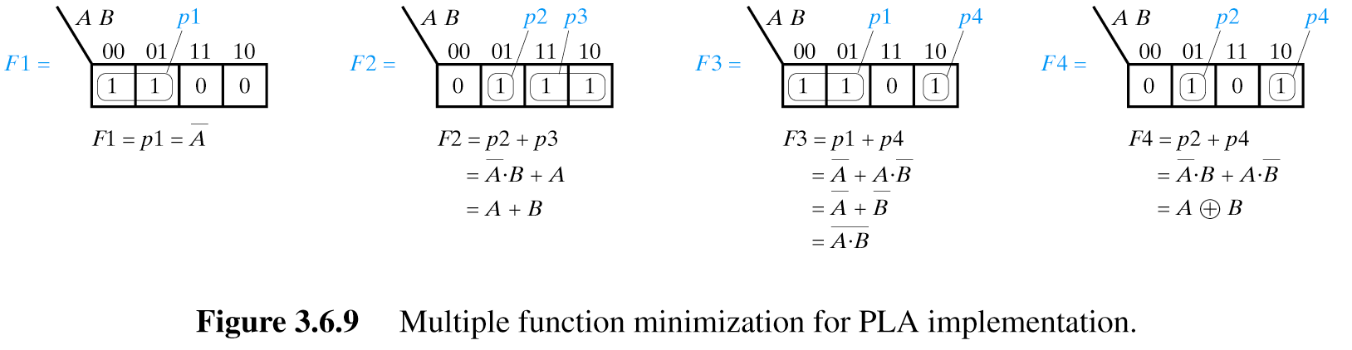
PLA Implementation
NOT, OR, NAND, XOR
A B F1 F2 F3 F4
0 0 1 0 1 0
0 1 1 1 1 1
1 0 0 1 1 1
1 1 0 1 0 0
What would have happened if we’d chosen a different covering for the K-map for F3?
Same number of terms…
Unable to share since the B’ term isn’t used anywhere else

Slide 24
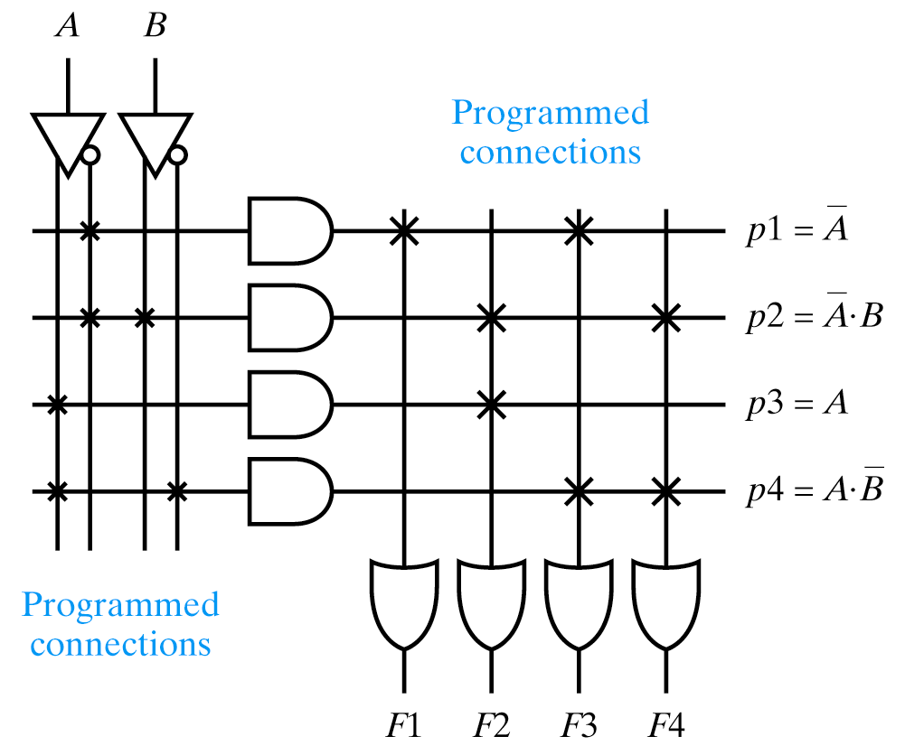
PLA Implementation
NOT, OR, NAND, XOR
A B F1 F2 F3 F4
0 0 1 0 1 0
0 1 1 1 1 1
1 0 0 1 1 1
1 1 0 1 0 0
What are the shared product terms?
Highlight in red

Slide 25
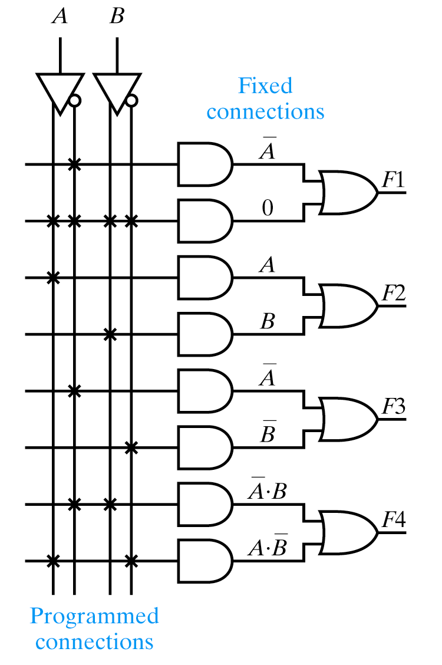
PAL Implementation
NOT, OR, NAND, XOR
A B F1 F2 F3 F4
0 0 1 0 1 0
0 1 1 1 1 1
1 0 0 1 1 1
1 1 0 1 0 0

Slide 26
Logic Conventions
Positive Logic Convention (PLC)
  Signals always “active high” (“asserted high”)
  Bubble or negation indicator to show complementation
Direct Polarity Indication (DPI)
  “mixed logic” notation
  Suffix (H) or (L) indicates active high or active low
  Polarity indicator or wedge to indicate active low
PLC DPI Type of
Signal Name Signal Name Signal
A or A(H) A(H) or A(L) Active High
B or B(H) B(H) or B(L) Active Low

Slide 27
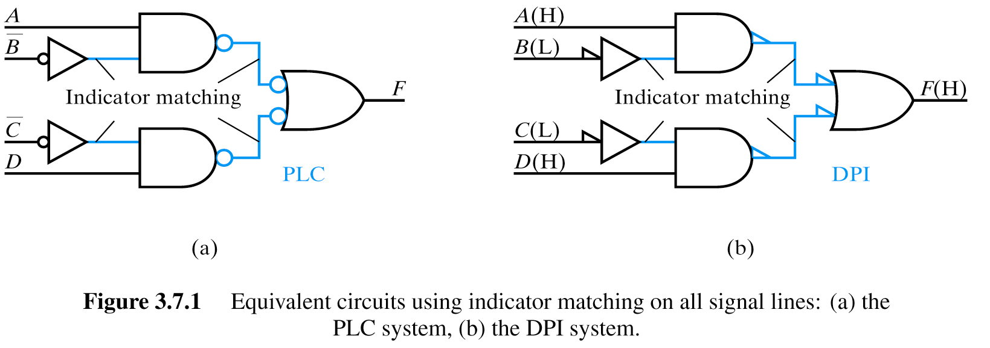
Indicator Matching
Positive Logic Convention (PLC)
Direct Polarity Indication (DPI)

Slide 28
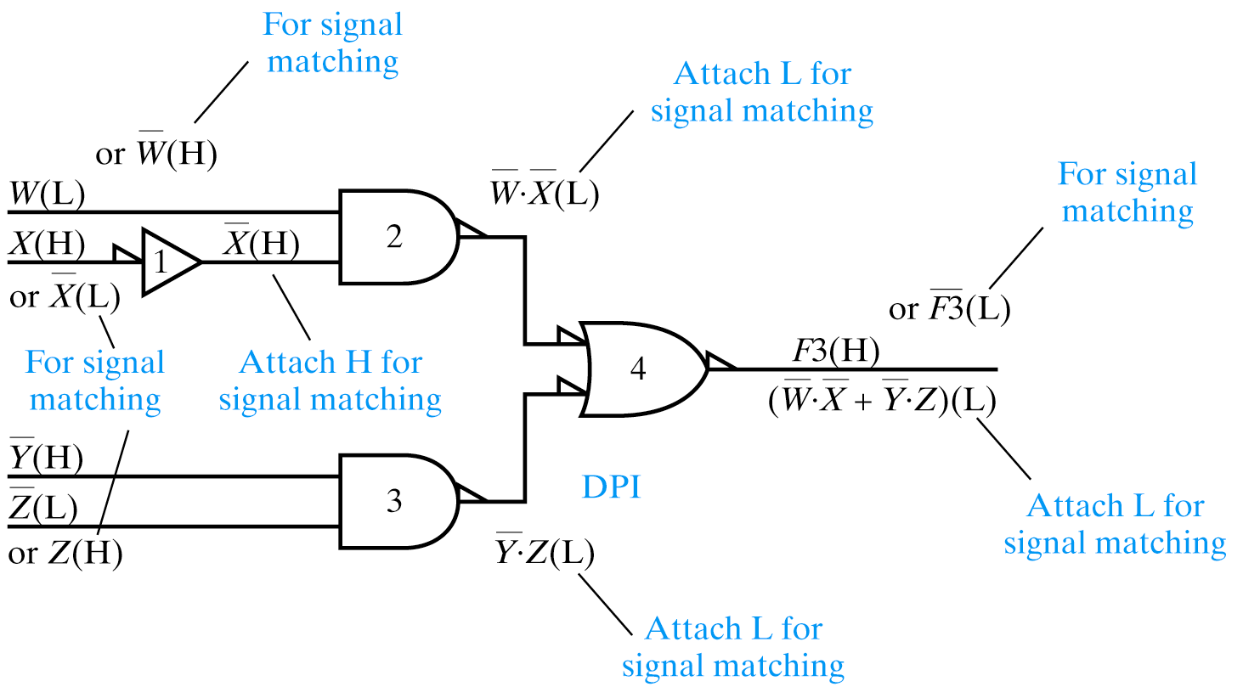
Detailed DPI Example
This is correct only if we assume the input names given

Slide 29
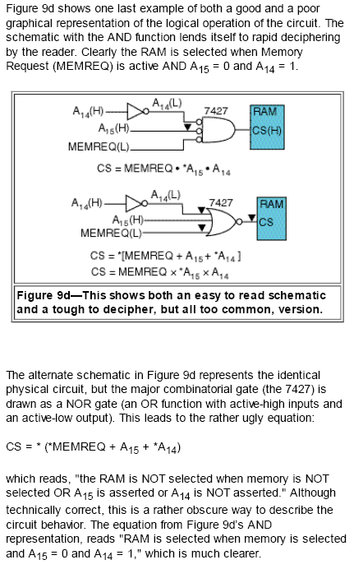

Slide 30
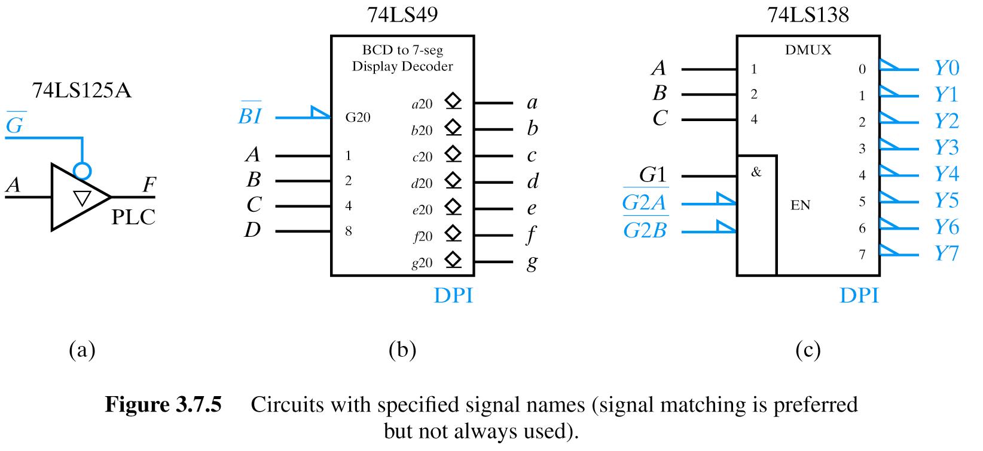
Databook Examples
Three-state bus buffer (buffer/driver).
High impedance or “Z” – will be discussed later
G is active low enable. A/F are active H.

Slide 31
Databook Examples
REFER TO DATA SHEET IN CLASS!!!
BCD to 7-segment display decoder with blanking control
Blanking input (BI) will be discussed in detailed example shortly
Open-collector outputs likewise (diamonds)
Symbol uses DPI with positive logic with signal matching (all active high except BI which has overbar and wedge)
Could have used A(H)…D(H) and a(H)…g(H) and BI(L) -- no overbar!

Slide 32
Databook Examples
DMUX
DMUX is decoder with an enable input.
Note G2A and G2B are active low while G1 is active H
Outputs are active L (unlike text!) and are note signal name matched

Slide 33
Sources
Prof. Mark G. Faust
John Wakerly

